Slide 1

UNIT I Introduction to Angular

Slide 2
Why Framework?
It reduce development time and increases productivity.
It remove complexity from design.
It provides reusable components
Problem finding and problem isolation becomes very easy.

Slide 3
What is Angular?
Angular is a platform and framework for building single-page client applications using HTML and TypeScript.
Angular is written in TypeScript.
It implements core and optional functionality as a set of TypeScript libraries that you import into your applications.
It helps you to structure your code, separate your concern and remove trivial code.

Slide 4

Typescript
TypeScript stands in an unusual relationship to JavaScript.
TypeScript offers all of JavaScript’s features, and an additional layer on top of these: TypeScript’s type system.
For example, JavaScript provides language primitives like string and number, but it doesn’t check that you’ve consistently assigned these. TypeScript does.
let helloWorld = "Hello World";
let helloWorld: string

Slide 5
Single Page Application(SPA)
A Single Page Application (SPA) is a single web page, website, or web application that works within a web browser and loads just a single document.
It does not need page reloading during its usage, and most of its content remains the same while only some of it needs updating.
the content needs to be updated, the SPA does it through JavaScript APIs.
users can view a website without loading the entire new page and data from the server.

Slide 6
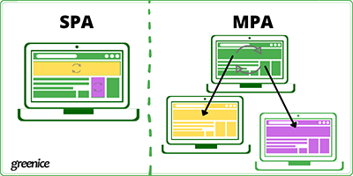

Slide 7
Angular Features
Data Bindings
9
1
Modules
Directives
8
Component
2
Services
7
Template
3
6
Validators
4
Pipe
5
Dependency Injection
Full Stack Web Development Lecture 1
7

Slide 8
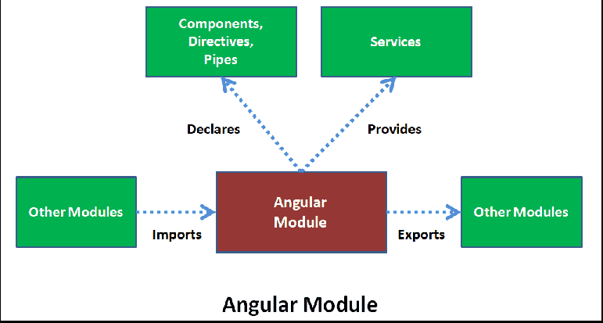
Modules
a module is a mechanism to group components, directives, pipes and services that are related, in such a way that can be combined with other modules to create an application.
Angular modules is classes.
a module can export or hide components, directives, pipes and services.
The exported elements are meant to be used by other modules.
Not exported (hidden) are just used inside the module itself and cannot be directly accessed by other modules of our application.

Slide 9
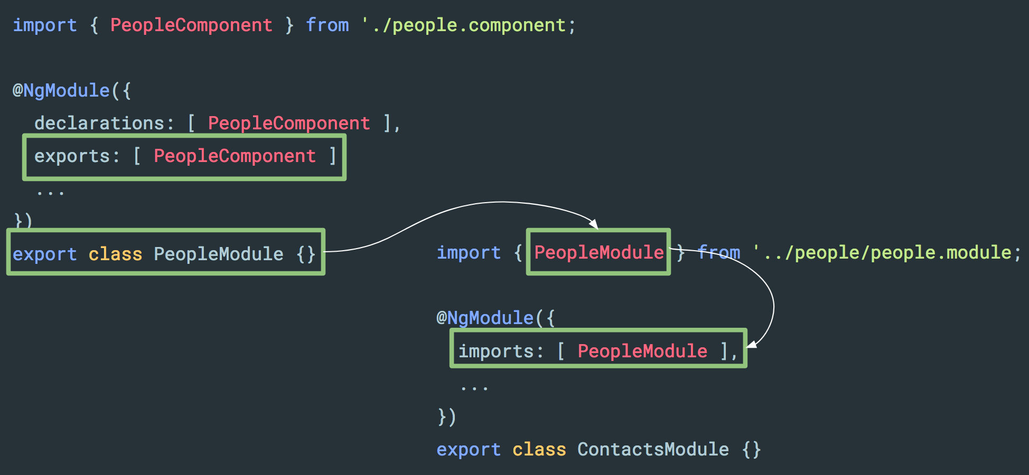
Modules

Slide 10
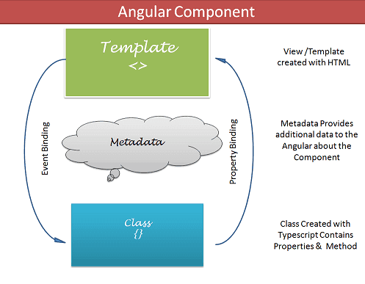
Component
Components are the most basic UI building block of an Angular app.
Each component consists of:
1. An HTML template that
declares what renders on the
page
2. A TypeScript class that defines
behavior
3. A CSS selector that defines how
the component is used in a
template
4. Optionally, CSS styles applied to
the template

Slide 11
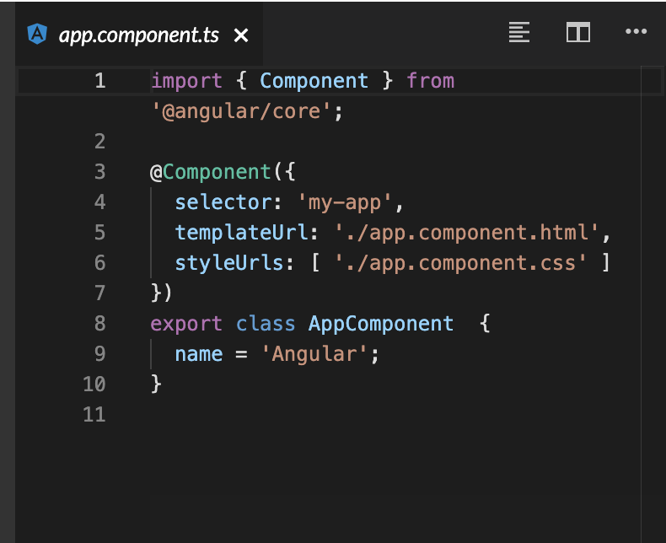
Component

Slide 12
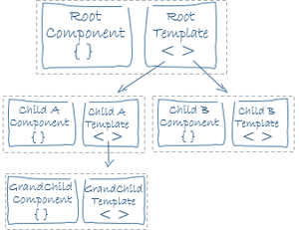
Template
a template is a blueprint for a fragment of a user interface (UI).
Templates are written in HTML.
tells Angular how to render the component.

Slide 13
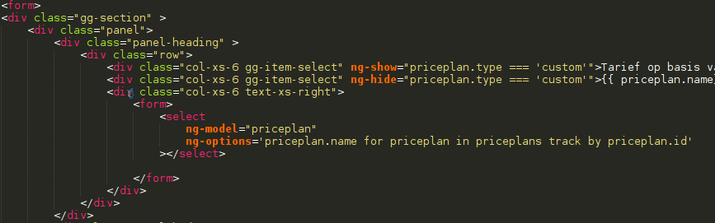
Templates

Slide 14
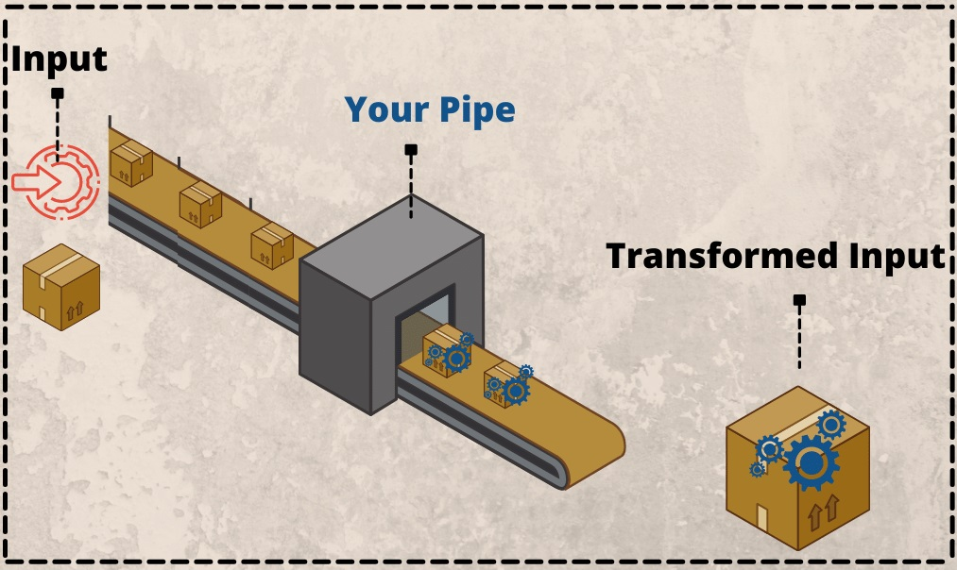
Pipe/Filter
Angular Pipes take data as input and transform it into an output.
The pipes purpose is to allow the transformation of an existing value and reusability.

Slide 15
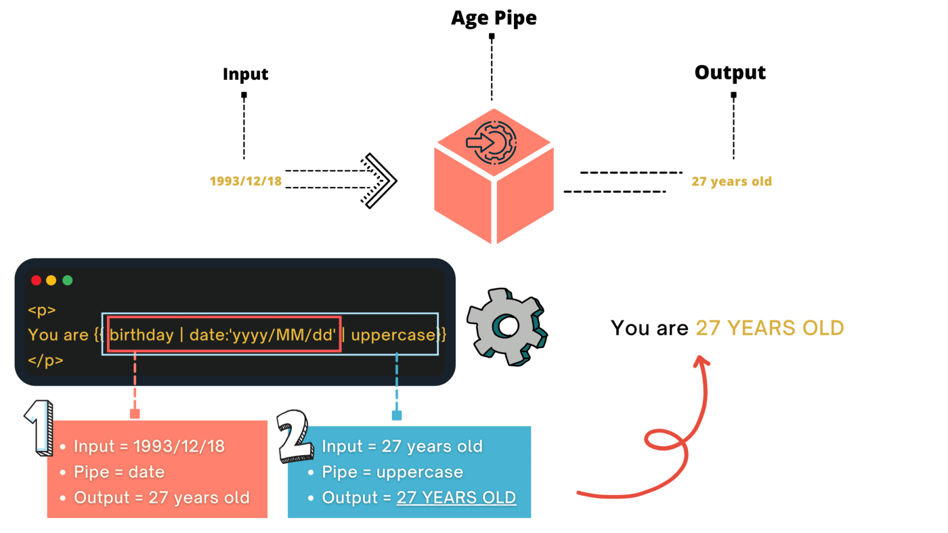
Pipe/Filter

Slide 16
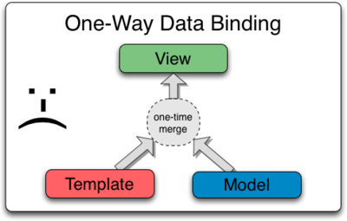
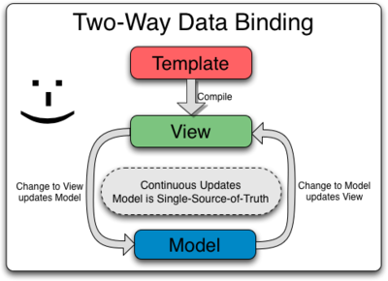
Data Binding
Data binding deals with how to bind your data from component to HTML DOM elements (Templates).

Slide 17
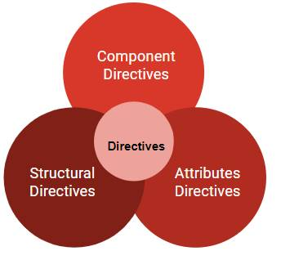
Directives
Directives in Angular are a fundamental development concept.
Directives are defined as classes that can add new behavior to the elements in the template or modify existing behavior.
The purpose of Directives in Angular is to maneuver the DOM, be it by adding new elements to DOM or removing elements and even changing the appearance of the DOM elements.
Directives have a name and can be predefined or custom-defined so that they can be called anything. Depending on the predefined directive, its use is determined – attribute, comment, element, or class.

Slide 18
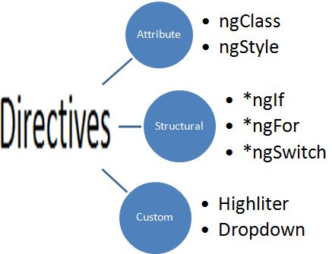
Directives

Slide 19
Validators
Forms are an essential part of every Angular application and necessary to get data from the user.
collected data is only valuable if the quality is right - means if it meets our criteria.
For example, email data should match the format as: any combinationation of digits or alphabet and dots and @ , then followed by domain name
Correct format
sam123@gmail.com
Xzs.dfge.123
wrong format

Slide 20
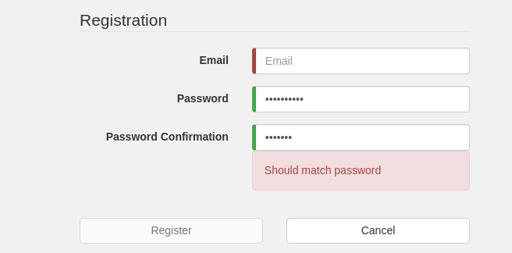
Validators

Slide 21
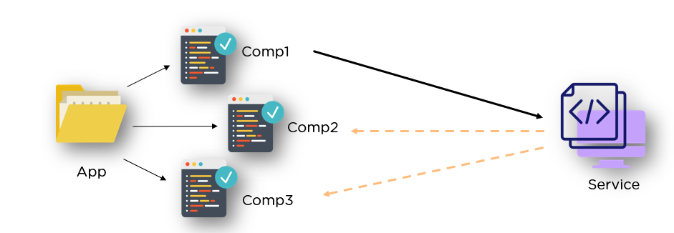
Services
Angular services are objects that get instantiated just once during the lifetime of an application.
They contain methods that maintain data throughout the life of an application.
data is available all the time.

Slide 22
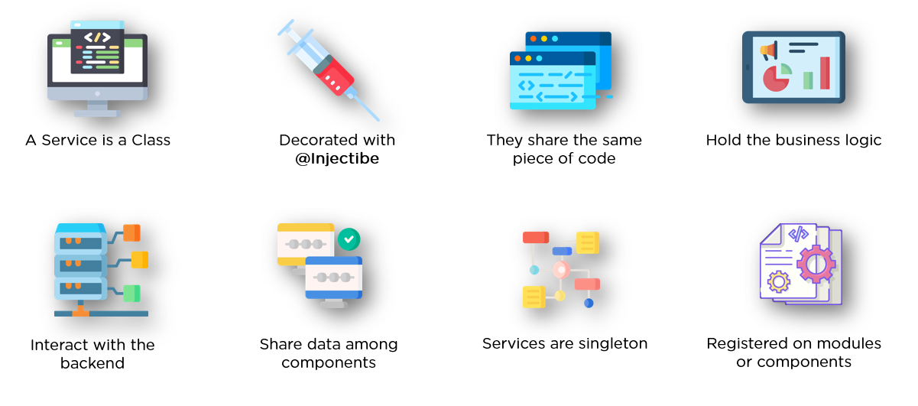
Services

Slide 23
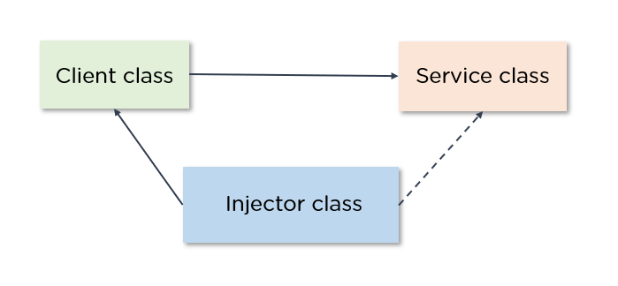
Dependency Injective
dependency injection is what makes a class independent of its dependencies.
Dependency injection enables the creation of dependent objects outside of a class while providing those very objects to a class in numerous ways.
Consider two classes, A and B. Let’s assume that class A uses the objects of class B. Normally, in OOPS, an instance of class B is created so that class A can access the objects. Using DI, we move the creation and binding of the dependent objects outside of the class that depend on them.

Slide 24
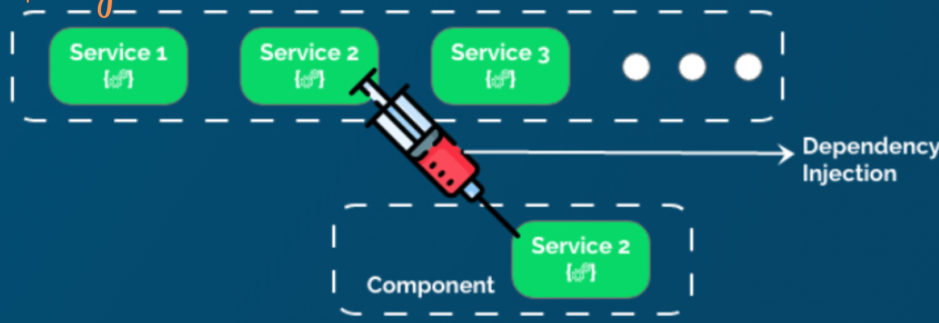
Dependency Injection

Slide 25
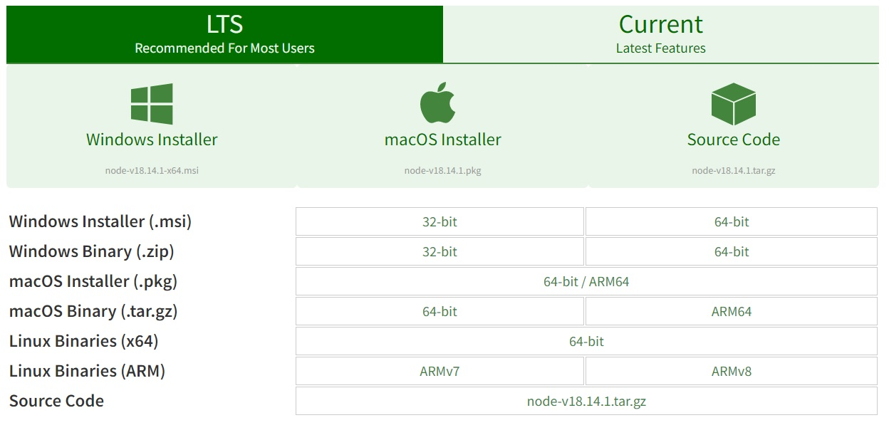
Angular Installation
Download Node JS: https://nodejs.org/en/download/

Slide 26
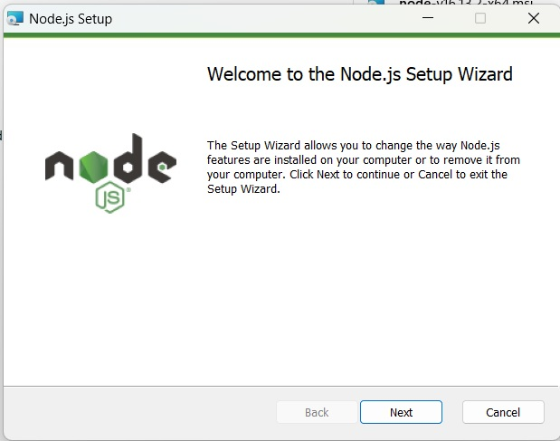
Angular Installation
2. Install Node JS:

Slide 27
Angular Installation
After installation a package manager tool for Node is available: npm (node package manager)
npm is used install all the packages required for web application development.
Angular cli can be installed using npm.

Slide 28
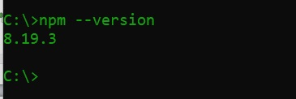
Angular Installation
6. Check whether Node is properly installed or not: In command prompt type type command
C:\>npm --verssion

Slide 29
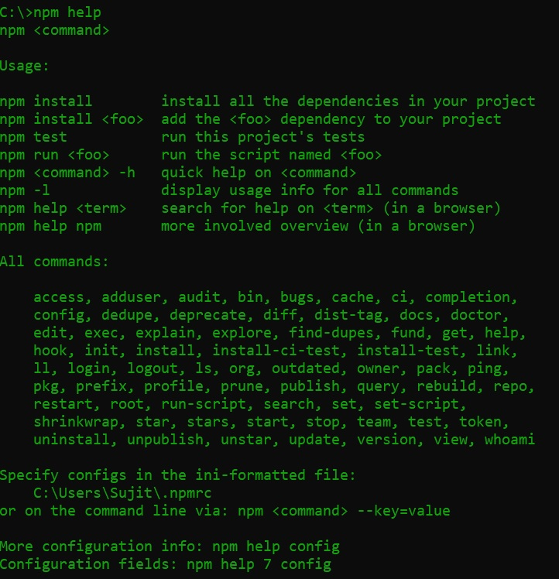
Angular Installation
7. To know all available command for npm type
C:\> npm help

Slide 30

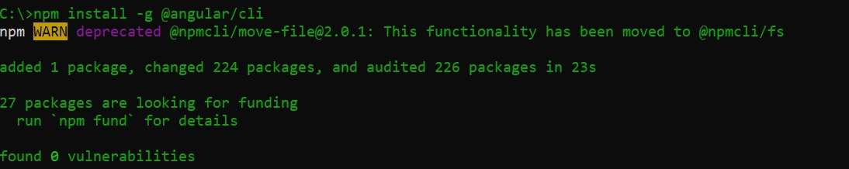
Angular Installation
8. Install Angular CLI: type the following command in command propmt
C:\>npm install –g @angular/cli
Install Globally
Reports How Many Packages have been installed

Slide 31
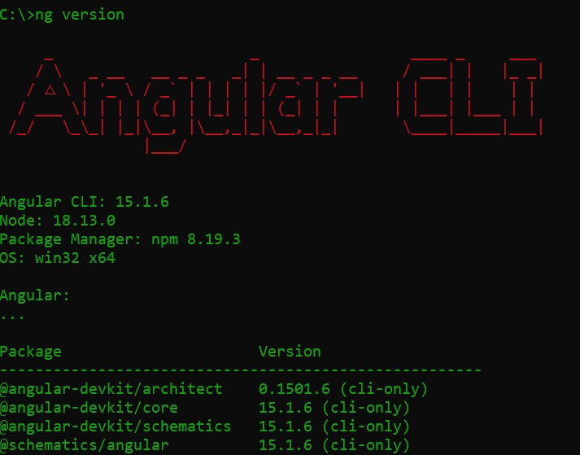
Angular Installation
9. After Installation we get another tool “ng” which is used to create angular projects. To check whether angular is installed or not, type:
C:\>ng version

Slide 32
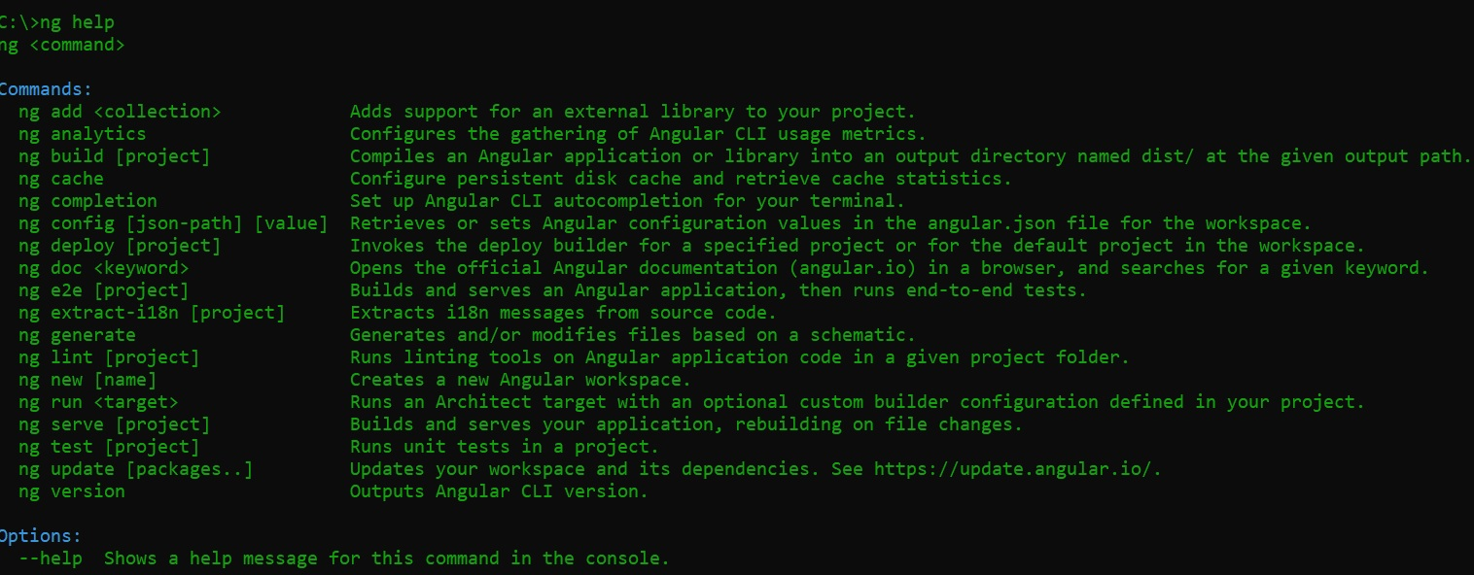
Angular Commands

Slide 33
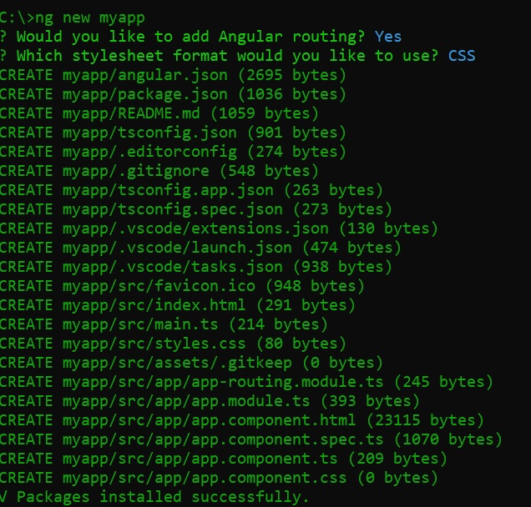
Angular Project
To create an Angular Project, type:
C:\>ng new project name
This can be any name

Slide 34
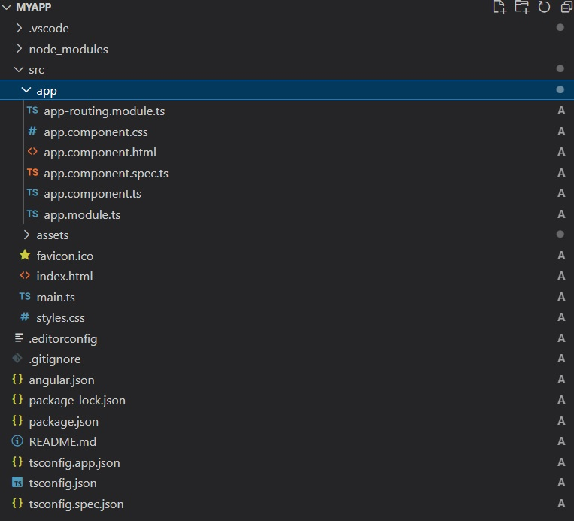
Angular Project
Contains all packages to run the application
The Main project Content
The home page for application

Slide 35
Angular Project File Description
File Name/ Folder Name | Description
.vscode | Contains all the configuration file
src | Contains App folder, hompage html file, home page style sheet, icon, editor configuration file, main.ts
App->app-routing.modules.ts | outsource your routing in a different file
App->app.component.ts | Contains all the codes needed for app component, like property class , required packages etc.
App->app.component.html | It is the template for app
App->app.component.css | It contains all the style applicable to app component
App->app.component.spec.ts | It is used to do unit testing for the component
App->app.module.ts | Modules are a way of organizing and separating your code.

Slide 36
Angular Project File Description
File Name/ Folder Name | Description
Src->main.ts | It contains information about root app
Src->indext.html | It is the home page of the project
Src->style.css | It contains styles which is applicable to all the apps and
Src->.editorconfig.json | a simple configuration file that contains a list of rules which can be applied to any IDE’s or code editors for proper formatting of code.
.gitignore | specifies intentionally untracked files that Git should ignore.
Angular.json | workspace-wide and project-specific configuration defaults settings. It is used by angular tools.
Package-lock.json | created for locking the dependency with the installed version. It will install the exact latest version of that package in your application and save it in package.json.
Package.json | It records important metadata about a project which is required before publishing to NPM, and also defines functional attributes of a project that npm uses to install dependencies, run scripts, and identify the entry point to our package.

Slide 37
Angular Project File Description
File Name/ Folder Name | Description
Tsconfig.json
Tsconfig.app.json
Tsconfig.spec.json

Slide 38
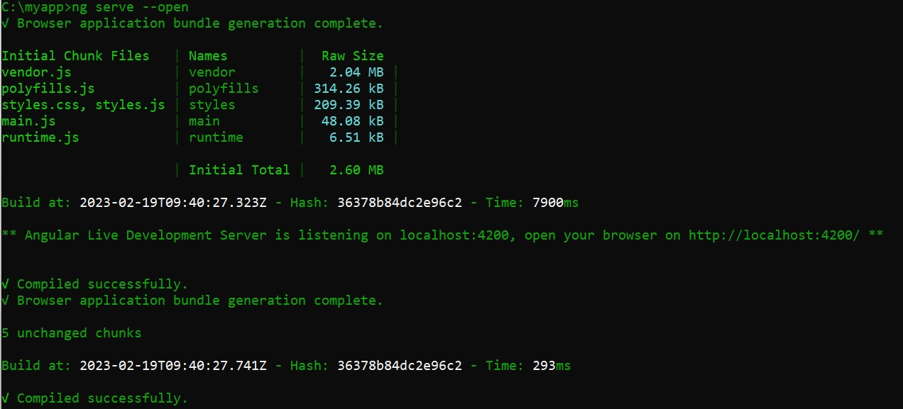
How To Execute Angular Project
In terminal type:
c:\>cd myapp
C:\myapp>ng server --open

Slide 39
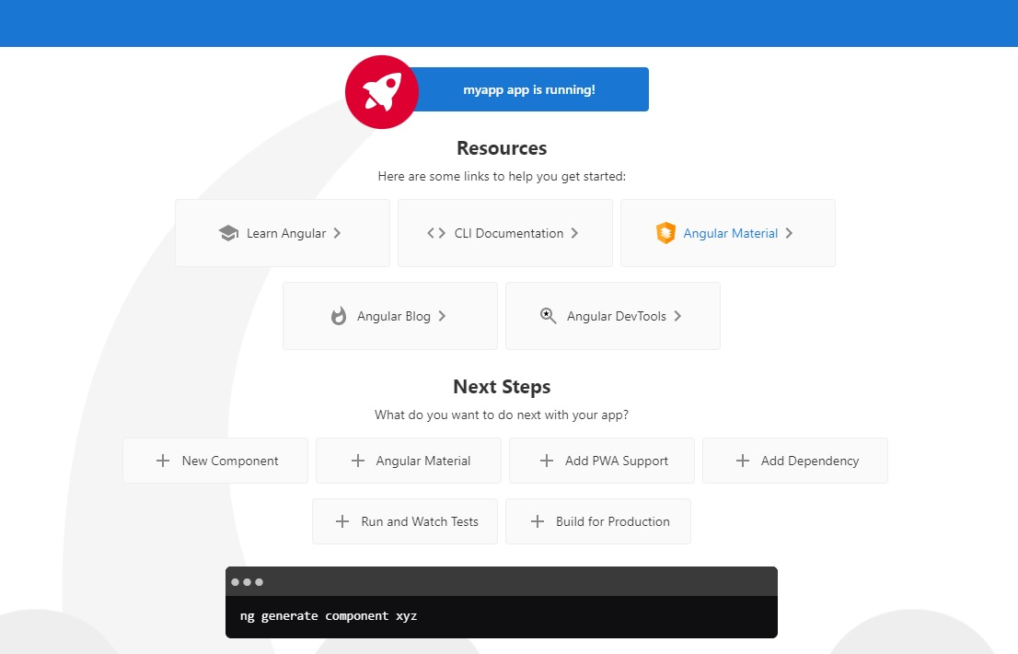
Output

Slide 40
Thank You

